Slide 1
Sampling and Inference
Background: #FCF7E4
Heading #4E75A3
Text #595959
Highlight #DD7E0E

Slide 2


Slide 3
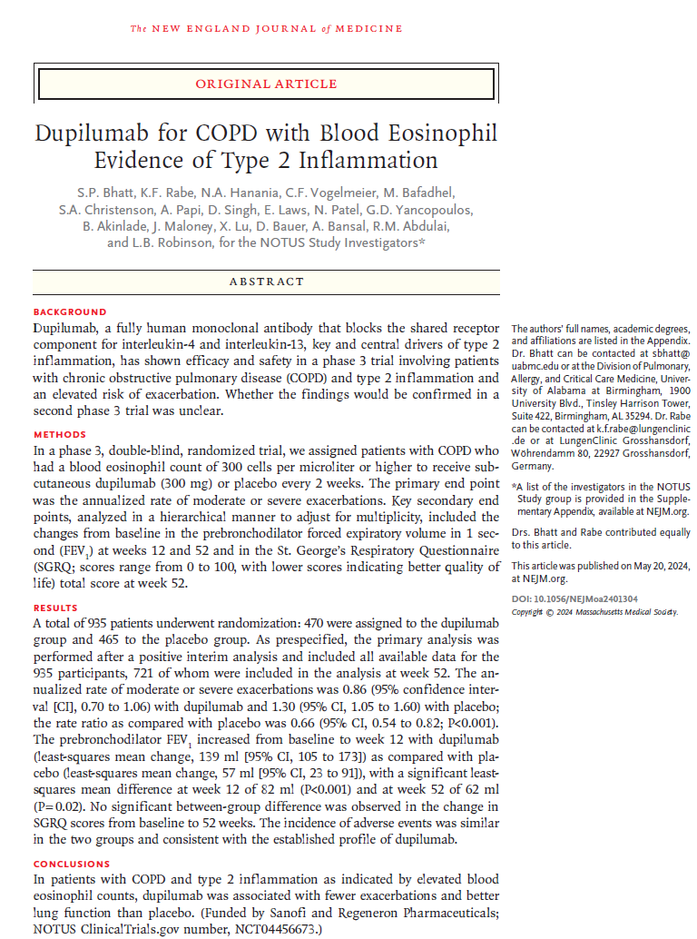
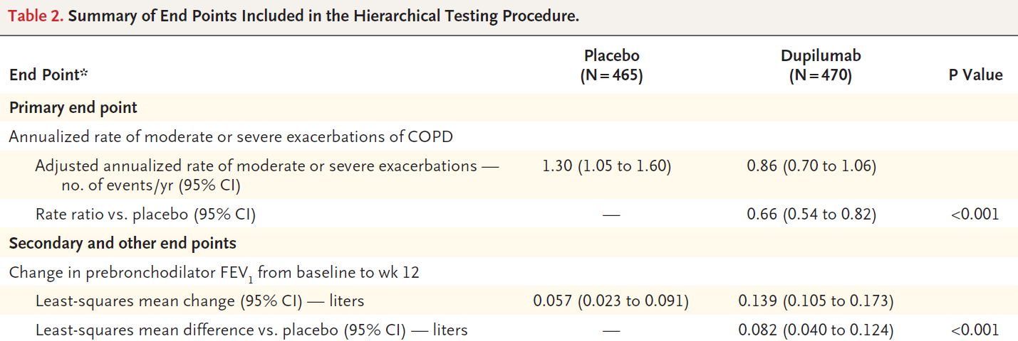
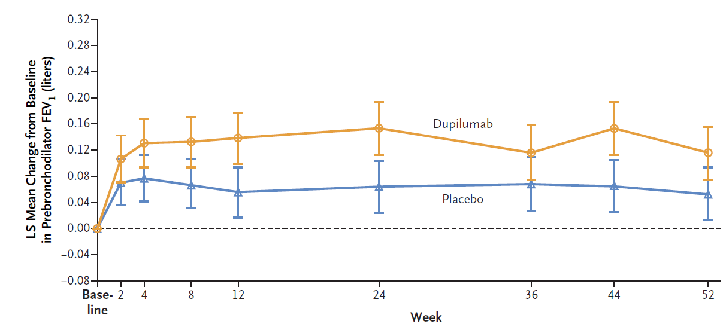
Sampling and Inference
Case Study: Effect of dupilumab versus placebo on mean change from baseline in prebronchodilator FEV₁ at week 12

Slide 4



Sampling and Inference
Each clinical trial should have a clearly-defined objective based on the following criteria:
Population
Variable
Treatment
Test statistic
ratio
%
Σ
Example:
To estimate the effect of dupilumab 300mg Q2W compared with placebo, on change from baseline in trough FEV₁ at Week 12, in the population of patients with COPD and blood eosinophil count >300 cells per µL.
The test statistic depends on the type of data. In this example the primary endpoint is continuous (quantitative) and the statistic of interest is the difference in means (mean in dupilumab group – mean in placebo group)

Slide 5
Sampling and Inference
Imagine an experiment including the whole population of adults with moderate-to-severe asthma. We could define the success or failure of the study simply by using descriptive statistics, and determine whether the difference between treatment groups was clinically significant.
However such an experiment is not feasible, and in a real clinical trial we take a sample of patients and use this to infer the properties of the population. This approach requires methods of inferential statistics.
We calculate the test statistic in our sample (e.g. treatment difference) and make inferences about the population.

Slide 6




Sampling and Inference
The true treatment effect is represented as:
$$θ$$
This is the difference in means between the drug X group compared to placebo, if we could observe the whole population.
The test statistic in our sample is represented as:
$$\hat{θ}$$
This is the treatment effect we observe in our sample (i.e. a clinical trial).
Note that and are the only Greek letters in this course!
$$θ$$
$$\hat{θ}$$

Slide 7






Sampling and Inference
We have the following definitions:
$$θ$$
True treatment effect: Fixed, but unknowable (i.e. “outside the cave”).
$$\hat{θ}$$
Estimated treatment effect: Observed in each study. This is our estimate of the truth (“shadows on the wall”).
So how do we find the “truth” ( )?
Results from each study provide an estimate of the treatment effect ( ).
But if we repeated the study, we’d observe a different value of each time.
It’s helpful to consider how varies between studies.
$$θ$$
$$\hat{θ}$$
$$\hat{θ}$$
$$\hat{θ}$$

Slide 8
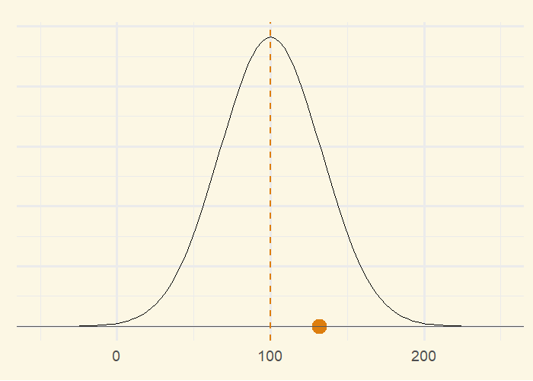
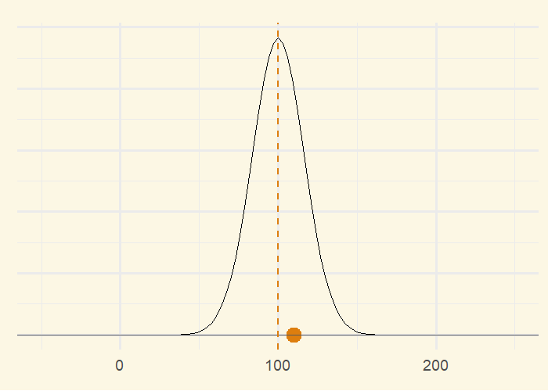



Sampling and Inference
N = 250
Definition:
Standard Error of the Mean (SEM): a measure of the variability of between repeated trials.
$$\hat{θ}$$
Small study
Higher variability (SEM = 33.1)
N = 1000
Large study
Lower variability (SEM = 16.5)
Estimated treatment effect: varies between repeated studies
The amount of variability depends on the sample size
$$\hat{θ}$$
$$\hat{θ}$$

Slide 9
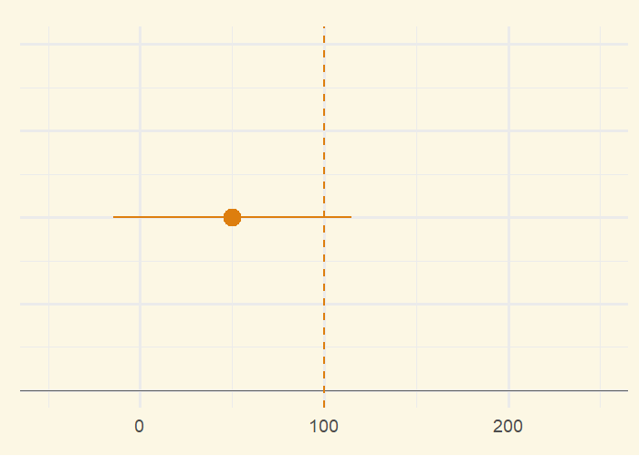
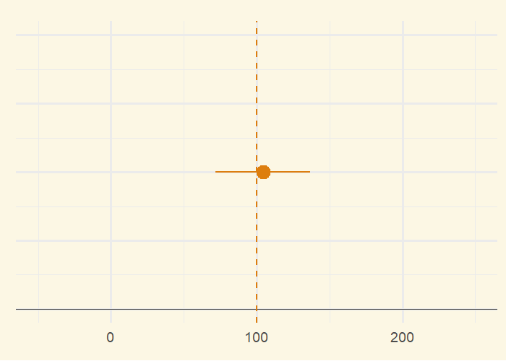



Sampling and Inference
If we assume the true effect ( ) is 100, how does vary between repeated trials?
$$θ$$
$$\hat{θ}$$
Definition:
95% Confidence Interval: range of values likely to contain the true effect ( ).
$$θ$$
N = 250
Smaller study:
Higher variability
Wider confidence intervals
Larger study:
Lower variability
Narrower confidence intervals
N = 1000
If we repeated the same study many times, 95% of the calculated intervals would include the true effect.
$$\hat{θ}$$

Slide 10
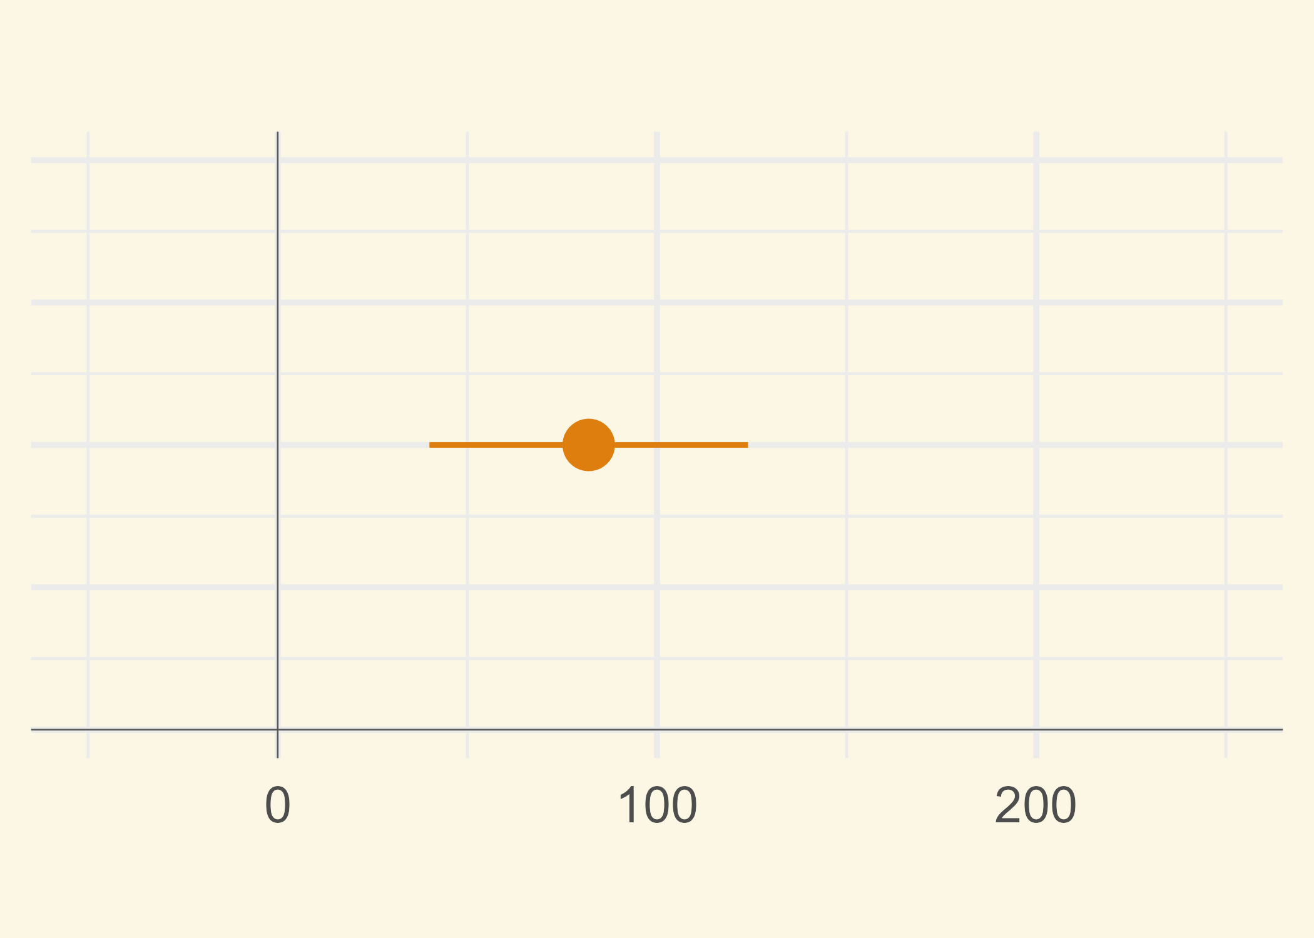

Sampling and Inference
Back to our case study, we are interested in interpreting the results from a single trial.
Remember, the true treatment effect ( ) is unknown.
The study results provide the estimate ( ) and 95% confidence interval (CI).
$$θ$$
$$\hat{θ}$$
Endpoint | Placebo (N=465) | Dupilumab (N=470)
Change in pre-brochodilator FEV1 from baseline to wk 12
Least-squares mean change (mL) | 57 | 139
Least-squares mean difference vs, placebo (95% CI) (mL) |  | 82.0 (40 to 124)
Because of the properties of the 95% CI, we can make the following statements:
“Plausible values for the true treatment effect are between 40 and 124 mL.”
“A range of treatment effects between 40 and 124 mL is compatible with the trial data.”
“The CI includes values that may be too small to be clinically meaningful.”
“Because the 95% CI excludes zero, the results are statistically significant.”
Weak effect
Moderate
effect
Strong effect
Don’t say:
“The true effect lies in the interval with 95% probability.”
“The treatment works for 95% of patients”.
“The CI captures 95% of individual patient outcomes”.
Pre-bronchodilator FEV1 change from baseline (mL)

Slide 11
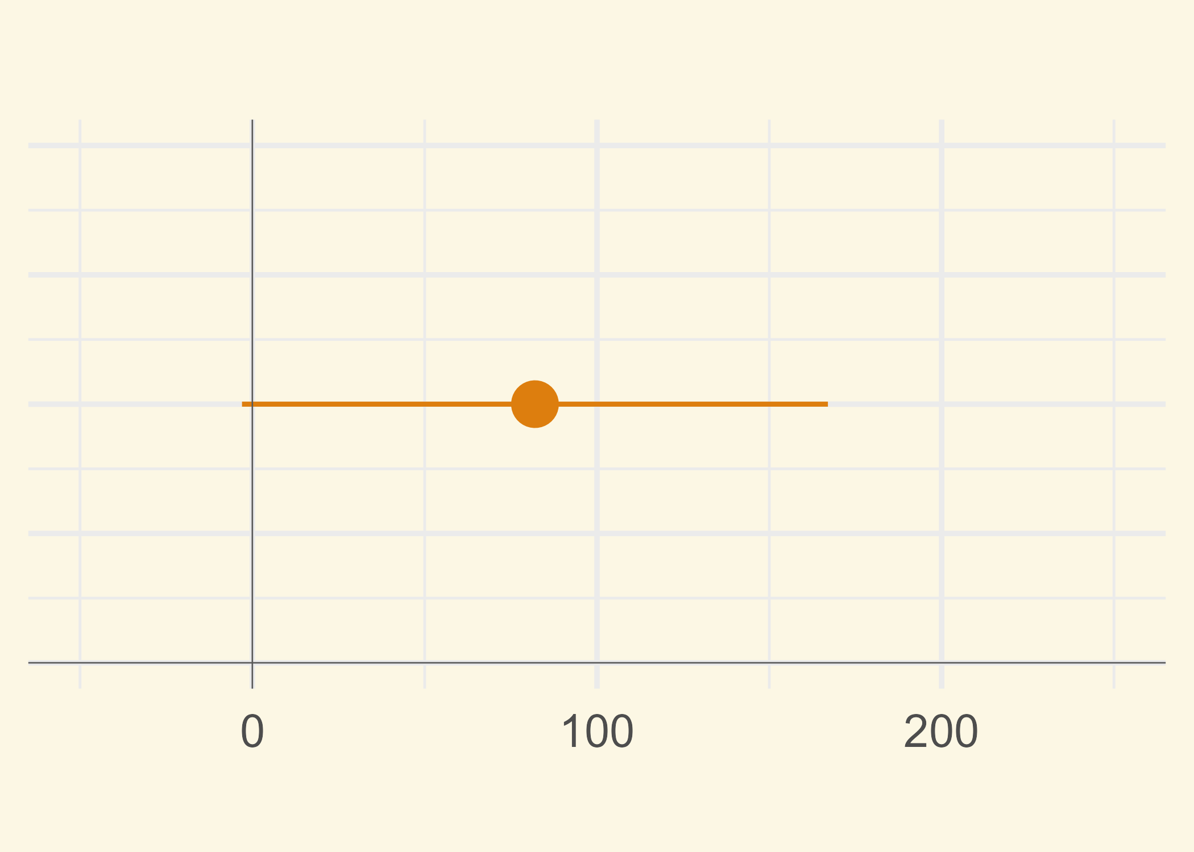
Sampling and Inference
What about p-values?
A p-value is a measure of how surprising your study results would be if the treatment truly had no effect.
A small p-value means the results would be unlikely to occur just by chance, and therefore provide evidence against the “no effect” assumption.
It does not tell you the size or importance of the effect, nor the probability that the treatment works.
Weak effect
Moderate
effect
Strong effect
p < 0.05
p-values should be treated with caution, as they encourage dichotomous thinking (“the drug works” vs. the “drug doesn’t work”). They should always be interpreted in conjunction with the CI.
In the upper example, the CI includes values that may be too small to be clinically meaningful, although the results are “statistically significant”.
Weak effect
Moderate
effect
Strong effect
p > 0.05
Pre-bronchodilator FEV1 change from baseline (mL)

Slide 12



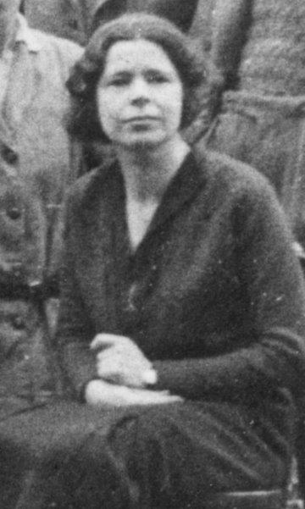
From Tea Test to T-Test
In the early 1920s, Ronald Fisher was working on experimental design at an agricultural research station. One afternoon Fisher fixed a cup of tea for colleague Muriel Bristol, pouring some milk into a cup and adding tea to it.
“I won’t drink that”, she declared explaining that she never drank tea unless the milk went in second.
Fisher was sceptical. “Let’s run a test,” he said. “We’ll make some tea each way and see if you can taste which cup is which.”
Fisher made eight cups of tea, four tea-first and four milk-first, presenting them in random order and letting her guess which were the four “Tea-first” cups.
Ronald Fisher
Actual Drink
Muriel’s Guess
T | M | M | T | T | M | T | M
 | M | M |  |  | M |  | M
Muriel Bristol

Slide 13
From Tea Test to T-Test
In the early 1920s, Ronald Fisher was working on experimental design at an agricultural research station. One afternoon Fisher fixed a cup of tea for colleague Muriel Bristol, pouring some milk into a cup and adding tea to it.
“I won’t drink that”, she declared explaining that she never drank tea unless the milk went in second.
Fisher was sceptical. “Let’s run a test,” he said. “We’ll make some tea each way and see if you can taste which cup is which.”
Fisher made eight cups of tea, four tea-first and four milk-first, presenting them in random order and letting her guess which were the four “Tea-first” cups.
Ronald Fisher
Actual Drink
Muriel’s Guess
T | M | M | T | T | M | T | M
T | M | M | T | T | M | T | M
To everybody’s surprise, Bristol got all guesses correct!
Muriel Bristol

Slide 14
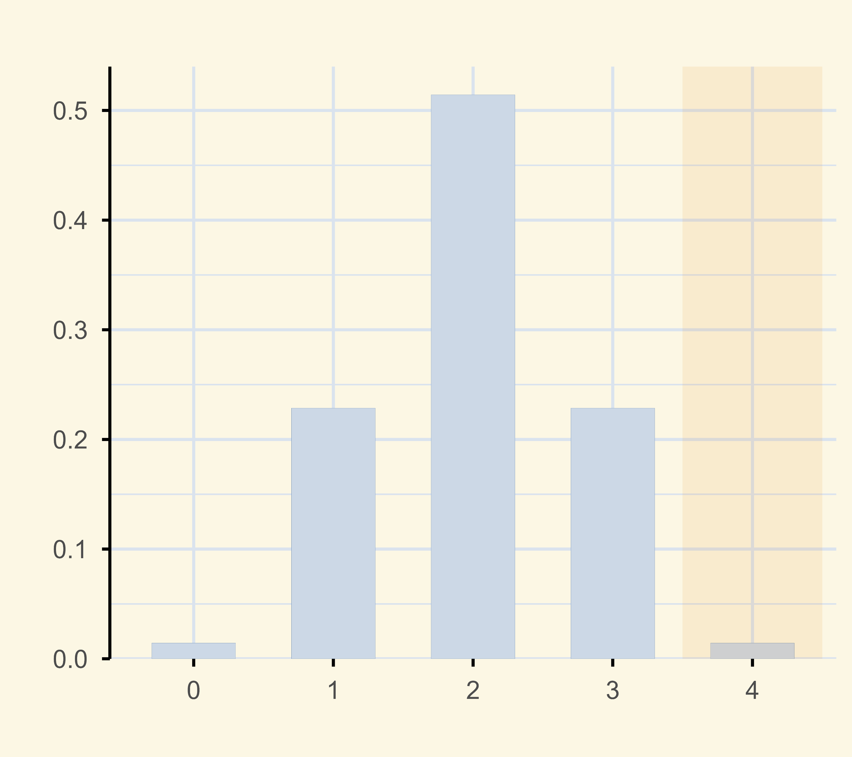
From Tea Test to T-Test
Fisher hypothesised that Muriel was guessing at random (called the null hypothesis). He then calculated that if the null hypothesis was true, the probability of the observed result was 1 in 70 (p=0.014).
Because this probability is very small, Fisher concluded that we can reject the null hypothesis. Muriel was able to tell the difference between “Tea first” and “Milk first” cups. This was one of the first recorded examples of a p-value.
What is a p-value?
A p-value tells you how likely is the result we observed, if in truth there’s no effect. A small p-value means the observed result would be surprising, if the null hypothesis were true.
Probability of different results
(null hypothesis)
A common fallacy is that the p-value is the probability that the null hypothesis is correct. But this wrong, because a p-value is defined only if the null hypothesis is correct.
Using Fisher’s approach, the p-value isn’t generally compared to a fixed threshold, i.e. there isn’t the concept of “statistical significance”.
Instead, they provide insight into experimental results (alongside other statistics), with smaller values representing increasingly stronger evidence against the null hypothesis.
Probability
p=0.014
Number of Correct Guesses
Notes:
It turns out that when you pour milk into boiling hot tea, the first drops of milk get superheated quickly and globules containing fats and proteins acquire a burnt flavour, which Muriel could taste.

Slide 15
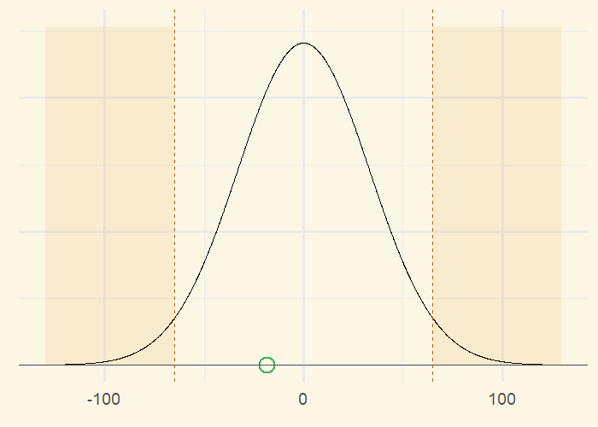
From Tea Test to T-Test
We return to our study comparing dupilumab and placebo in mean change from baseline in FEV₁.
Similarly to the Tea-test, we first define a null hypothesis (“dupilumab and placebo are the same”). As before, we reject the null hypothesis if the result we observed in our experiment would be surprising, were the null hypothesis to be true.
We set up our test to reject the null hypothesis if the estimated treatment effect falls outside the range ±65 mL. Because we can reject the null hypothesis in both directions, this is known as a two-tailed test.
Here we look at a simulation where the null hypothesis is true.
Sometimes we falsely reject the null hypothesis, when in fact it is true. This happens about once in every 20 trials and known as a “Type I” error.
We want this is happen quite rarely, because it could mean that an ineffective drug produces a spurious positive result by chance.
Reject the
null hypothesis
Reject the
null hypothesis

Slide 16
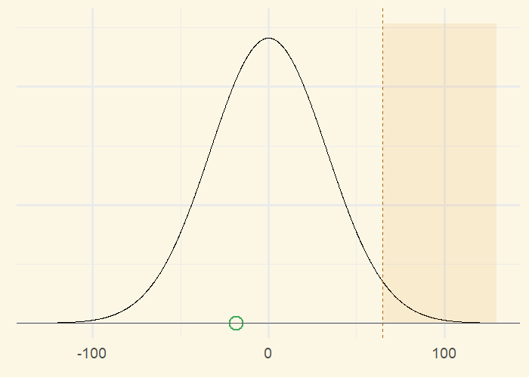
From Tea Test to T-Test
A different approach is to reject the null hypothesis if the estimated treatment effect is greater than +65 mL.
This is known as a one-tailed test.
This is the test we’ll use in our example.
Reject the
null hypothesis

Slide 17
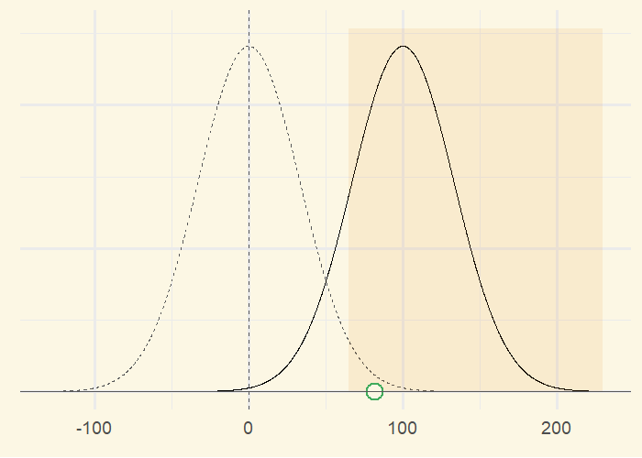
From Tea Test to T-Test
Imagine now that dupilumab is superior to placebo.
In this scenario, we want to reject the null hypothesis with a high probability.
Sometimes we fail to reject the null hypothesis, which is known as a Type II error (false negative).
In the simulation, we correctly reject the null hypothesis about X% of the time. This is known as the power of the test.
Reject the
null hypothesis

Slide 18
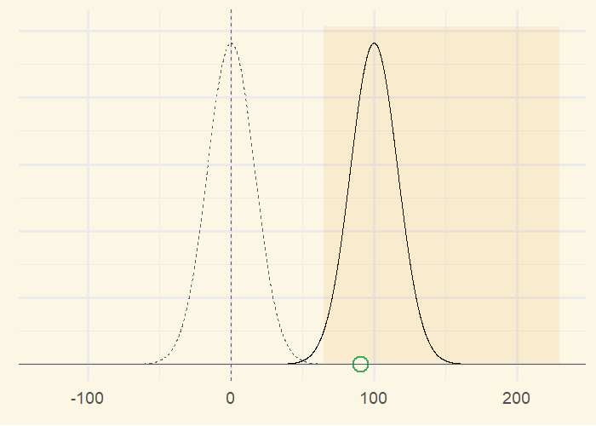
From Tea Test to T-Test
x
x
Reject the
null hypothesis

Slide 19
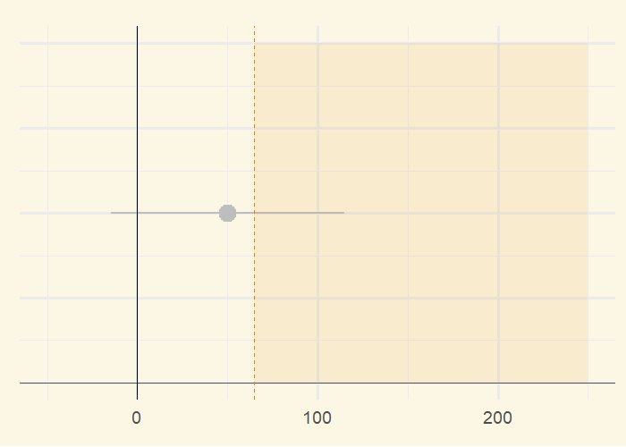
From Tea Test to T-Test
Reject the
null hypothesis

Slide 20
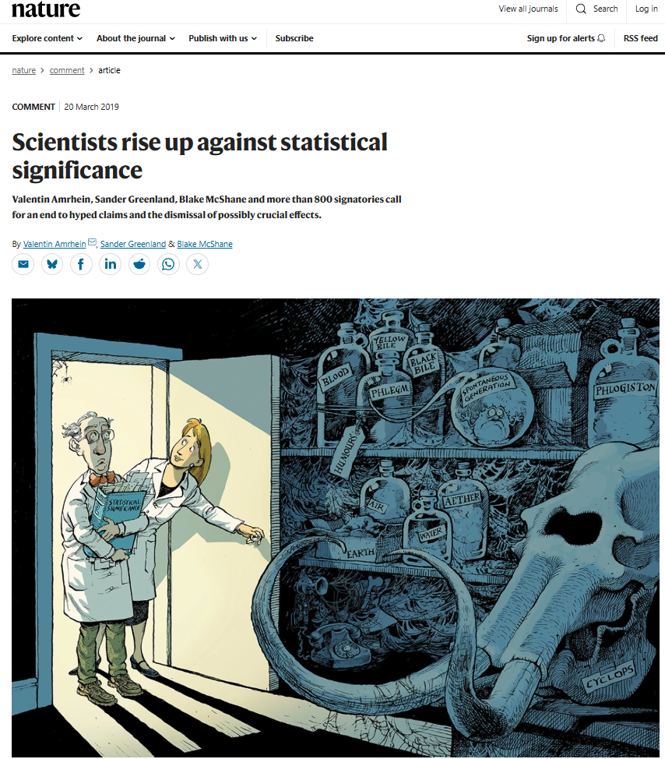
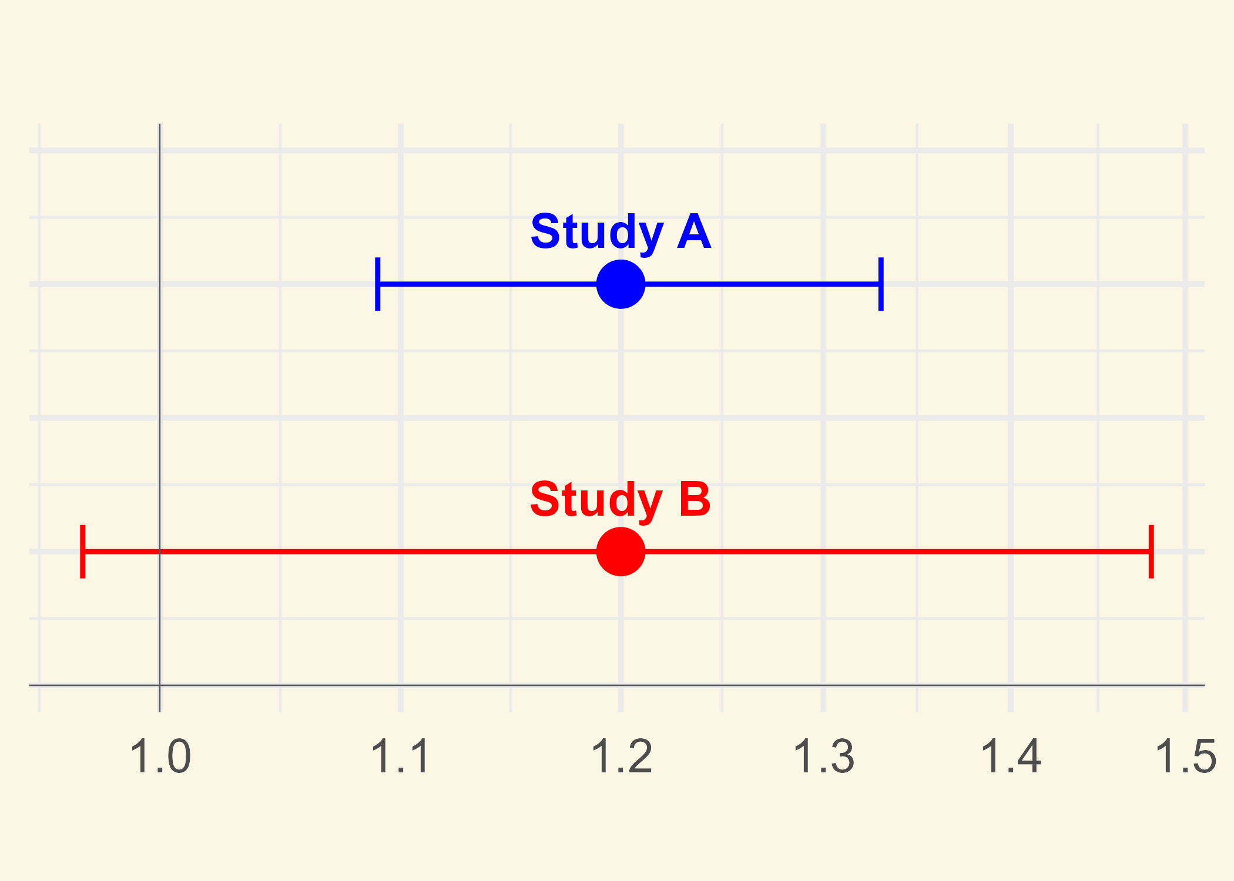
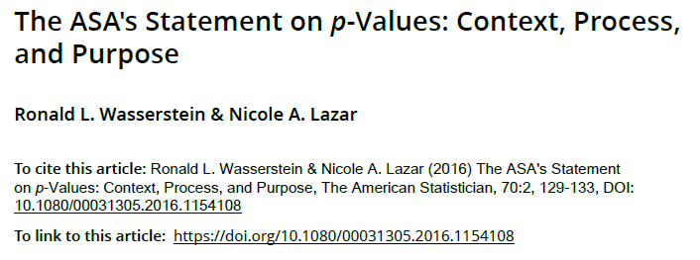
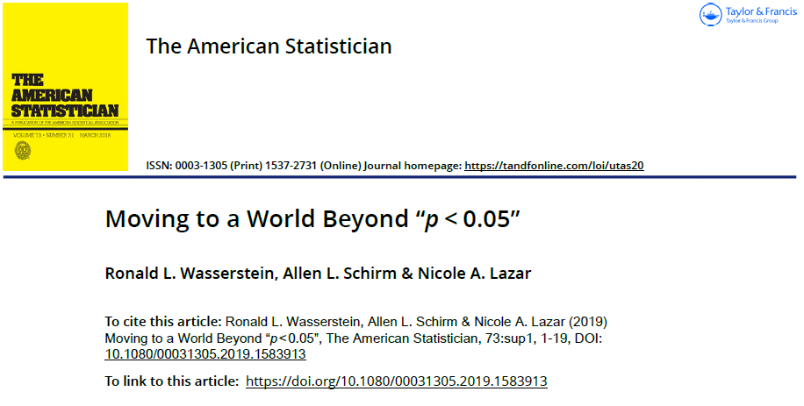
From Tea Test to T-Test
p-values can have a useful role in the scientific and medical literature, but use of “statistically significance” creates as an artificial yes/no dichotomy is controversial and a topic of recent debate.
Case Study
In a safety analysis for an anti-inflammatory drug, results for study B were “statistically non-significant” (p=0.091), with a conclusion “exposure was not associated with atrial fibrillation”.
However study A has previously showed a statistically significant outcome (p=0.0003) with exactly the same estimate of 20% increase in risk!
No
Effect
Increased
Effect
However p-values are relevant in the context of dichotomous decision-making by health authorities. Regulatory approval generally requires a pivotal trial with p<0.05 in the primary endpoint.
Don’t say:
“There is no effect because p > 0.05”
“p-value is the probability the treatment has no effect”
“Statistical significance is proof of clinical importance”
“A smaller p-value means one treatment is better than another”

